Slide 1
Lipid Synthesis

Slide 2
Learning Objectives
Describe the conditions and tissues wherein fatty acids are generated, and from what precursors.
Explain the regulation of fatty acid biosynthesis by metabolite levels and hormones, including how it is ensured that beta-oxidation and de novolipogenesis do not occur simultaneously.
Understand the energy costs of generating fatty acids from glucose, compared with using glucose for fuel. Included in this is the source of carbon units, and reducing equivalents that are necessary for fatty acid biogenesis.
Analyze the role of citrate in co-ordination of glycolysis, TCA cycle activity and lipogenesis.
Explain the causes of lipodystrophy, including the metabolic consequences of ectopic fat deposition.
Understand how transcriptional and post-translational regulation control triglyceride synthesis and cholesterol synthesis.
Analyze the cellular conditions that lead to cholesterol synthesis and ketogenesis.
Describe the roles and activation of SREBP1 and SREBP2 in fatty acid/triglyceride and cholesterol biogenesis respectively.

Slide 3
Quiz Question #2
Which enzyme is not regulated by citrate levels?
Acetyl-CoA Carboxylase (ACC)
HMG-CoA Reductase (HMGCR)
Phosphofructokinase 1 (PFK1)
They are all regulated by citrate levels

Slide 4
Quiz Question #2
What is the rate limiting enzyme for de novo lipogenesis?
Acetyl-CoA Carboxylase
ATP-Citrate Lyase
Fatty Acid Synthase
HMG-CoA Reductase

Slide 5
Quiz Question #3
What macromolecule is the most energetically costly to synthesize in humans?
Palmitate (C16:0) from Glucose
Palmitoleate (C16:1) from Glucose
Alanine from Glucose
Lysine from Glucose

Slide 6
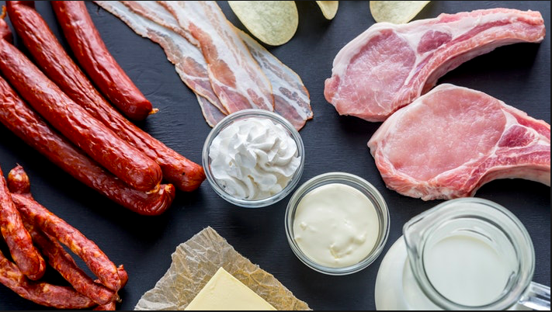
Natural vs Artificial Trans fat
Presented By: Ayousha Acharya

Slide 7
TRANS FAT
Trans fat, or trans-unsaturated fatty acids, trans fatty acids, are a type of unsaturated fat that occur in small amounts in nature, but became widely produced industrially from vegetable fats for use in margarine, snack food, packaged baked goods, and frying fast food.
Although trans fats are edible, consumption of trans fats has been shown to increase the risk of coronary artery disease in part by raising levels of the lipoprotein LDL (often referred to as "bad cholesterol"), lowering levels of the lipoprotein HDL (often referred to as "good cholesterol”)
Trans fatty acids have long been used in food manufacturing due in part to their melting point at room temperature, texture, stability and is very inexpensive.
Notes:
Trans fat has been shown to consistently be associated, in an intake-dependent way, with increased risk of coronary artery disease
increasing triglycerides in the bloodstream and promoting systemic inflammation

Slide 8
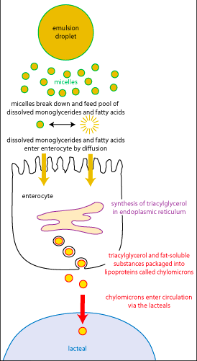
Trans Fat Digestion
The key issue in the digestion and absorption of fats is one of solubility: trans fat are hydrophobic.
First enzymatic digestion occurs in oral cavity by Lingual Lipase.
Once entering into the stomach, gastric lipase acts on it.
Emulsification
Absorption and Digestion in the small intestine
Notes:
Concern has existed in case of hydrogenated fats, as they may have adverse consequences because natural essential fatty acids are destroyed and the new artificial isomers are structurally similar to saturated fats, lack the essential metabolic activity of the parent compounds, and inhibit the enzymatic desaturation of linoleic and linolenic acid

Slide 9
TYPES OF TRANS FAT
NATURAL TRANS FAT | ARTIFICIAL TRANS FAT
Naturally-occurring trans fats are produced in the gut of some animals and foods made from these animals (e.g., milk and meat products) may contain small quantities of these fats. | Artificial trans fats (or trans fatty acids) are created in an industrial process that adds hydrogen to liquid vegetable oils to make them more solid.
Natural trans fats in your diet have been thought to have some potential benefit to aid in both muscle building and fat loss efforts. | These hydrogenated oils cause inflammation inside of your body, which signals the deposition of cholesterol as a healing agent on artery walls.
Vaccenyl and Conjugated linoleyl | Partially hydrogenated vegetable oil
Notes:
Artificial trans fatty acids are produced by partial hydrogenation of vegetable or fish oils with hydrogen gas and a metal catalyst.
Artificial trans fats are the outcast of the fat family. Even the This is because artificial trans fats lower good cholesterol or HDL and increase bad cholesterol, or LDL.
However, keep in mind that the quantity of healthy trans fats in the meat and dairy of ruminant animals is greatly reduced by mass-production methods of farming and their grain and soy heavy diets. Meat and dairy from grass-fed, free-range animals always have much higher quantities of these beneficial fats.

Slide 10
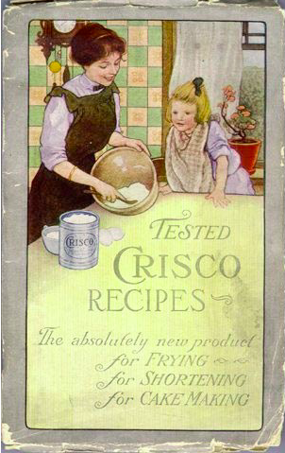
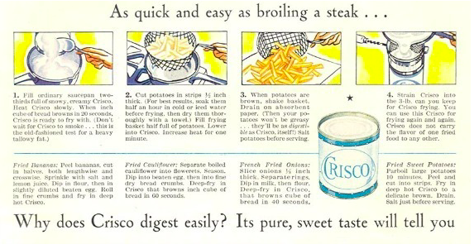
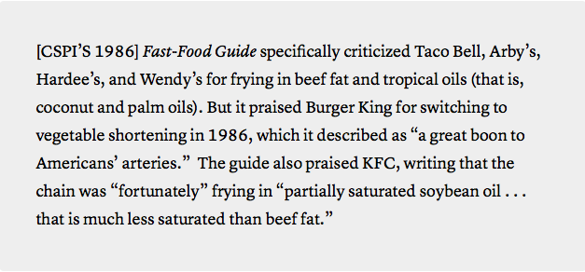
Notes:
unsaturated trans fats of margarine were healthier than the saturated fats of butter

Slide 11
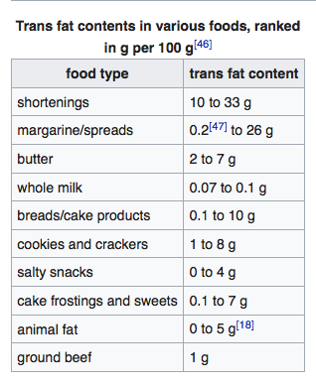
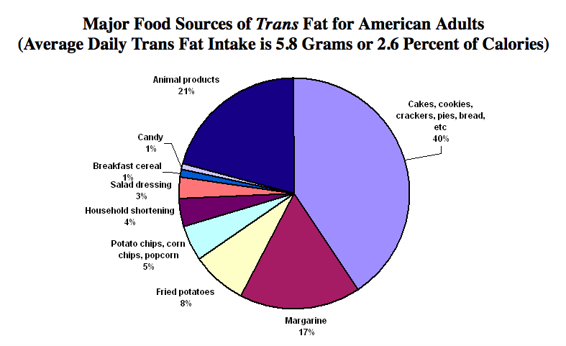
TRANS FAT IN FOOD

Slide 12
Case Studies
Forty subjects (19 men and 21 women) completed the study. Compared with TFAs from industrially produced sources, TFAs from natural sources significantly increased HDL cholesterol in women but not in men. increases in LDL-cholesterol concentrations were observed in women, but not in men, after the consumption of TFAs from natural sources.
Two Canadian studies have shown that the natural trans fat vaccenic acid, found in beef and dairy products, could actually be beneficial compared to hydrogenated vegetable shortening, or a mixture of pork lard and soy fat, by lowering total and LDL and triglyceride levels. A study by the US Department of Agriculture showed that vaccenic acid raises both HDL and LDL cholesterol, whereas industrial trans fats only raise LDL without any beneficial effect on HDL.
By calculating the intake of trans fatty acids from dietary questionnaires completed by 85,095 women without diagnosed CHD, stroke, diabetes, or hypercholesterolaemia in 1980. During 8 years of follow-up, there were 431 cases of new CHD After adjustment for age and total energy intake, intake of trans isomers was directly related to risk of CHD.
Notes:
Do trans fatty acids from industrially produced sources and from natural sources have the same effect on cardiovascular disease risk factors in healthy subjects
TFAs from industrially produced and from natural sources have different effects on CVD risk factors in women. The HDL cholesterol–lowering property of TFAs seems to be specific to industrial sources.
non-fatal myocardial infarction or death from CHD
Additional control for established CHD risk factors, multivitamin use, and intakes of saturated fat, monounsaturated fat, and linoleic acid, dietary cholesterol, vitamins E or C, carotene, or fibre did not change the relative risk substantially. The association was stronger for the 69 181 women whose margarine consumption over the previous 10 years had been stable

Slide 13
Other Health Risks
Alzheimer Disease
Cancer
Diabetes
Obesity
Infertility in Women
Major Depressive Disorder

Slide 14
Recommendations
A 2% absolute increase in energy intake from trans fat has been associated with a 23% increase in cardiovascular risk.
Denmark has shown it is possible to all but eliminate commercial sources of trans fats from the diet, total elimination is not possible in a balanced diet due to their natural presence in dairy and meat products.
The American Heart Association recommends limiting trans fats to <1% energy, and the American Dietetic Association, the Institute of Medicine, US Dietary Guidelines, and the National Cholesterol Education Project all recommend limiting dietary trans-fat intake from industrial sources as much as possible.
FDA came to the conclusion in 2013 that trans fat were no longer “generally recognized as safe” and as a result, gave the food industry three years to phase them out.

Slide 15
Reference
Jean-Michel Chardigny, Frédéric Destaillats, Corinne Malpuech-Brugère,Julie Mouln; Do trans fatty acids from industrially produced sources and from natural sources have the same effect on cardiovascular disease risk factors in healthy subjects? Results of the trans Fatty Acids Collaboration (TRANSFACT) study1,2,3,4
Mike Geary; Good Trans Fats vs. Bad Trans Fats; http://www.truthaboutabs.com/trans-fats.html
A Ascherio and W C Willet; Health effects of trans fatty acids; http://ajcn.nutrition.org/content/66/4/1006S.short
lW.C.WillettMD(Prof)ªM.J.StampferMDªJ.E.MansonMDªG.A.ColditzMBªF.E.SpeizerMD(Prof)ªB.A.RosnerPhD(Prof)^{a;} Intake of trans fatty acids and risk of coronary heart disease among women; http://www.sciencedirect.com/science/article/pii/014067369390350P
ValentinaRemigPhD, RD, FADABarryFranklinPhDSimeonMargolisMD, PhDGeorgiaKostasMPH, RD, LDTheresaNeceMS, RD, LDJames C.StreetPhD; Trans Fats in America: A Review of Their Use, Consumption, Health Implications, and Regulation; http://www.sciencedirect.com/science/article/pii/S000282230902094X
Katan MB¹, Zock PL, Mensink RP; Trans fatty acids and their effects on lipoproteins in humans; https://www.ncbi.nlm.nih.gov/pubmed/8527230

Slide 16


Slide 17
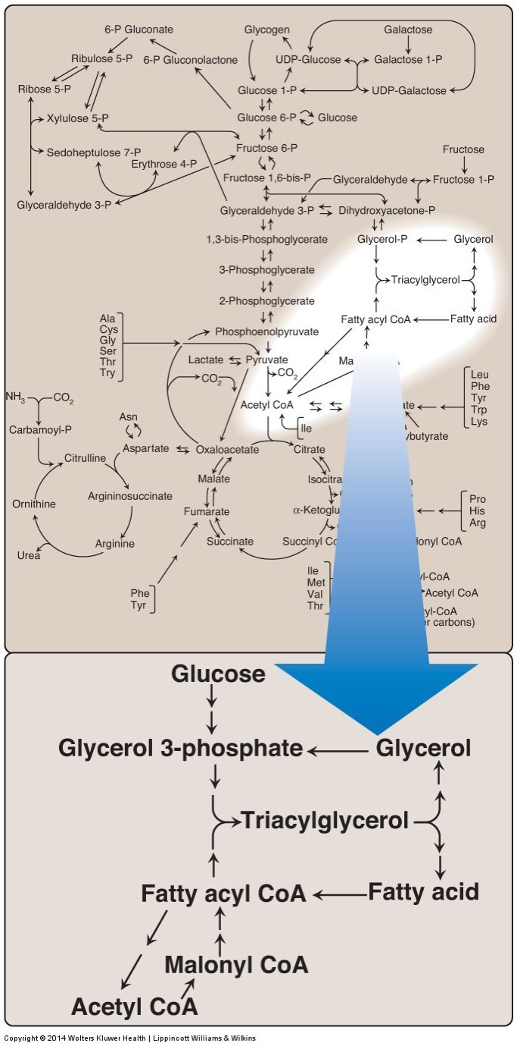
Synthesis of Fatty Acids
Two sources of fatty acids
Dietary
Synthesis from precursors (de novo)
Main sites of biosynthesis: liver and adipose tissue

Slide 18
Key Regulatory Steps
ATP Citrate Lyase
Acetyl CoA Carboxylase
Fatty Acid Synthase

Slide 19
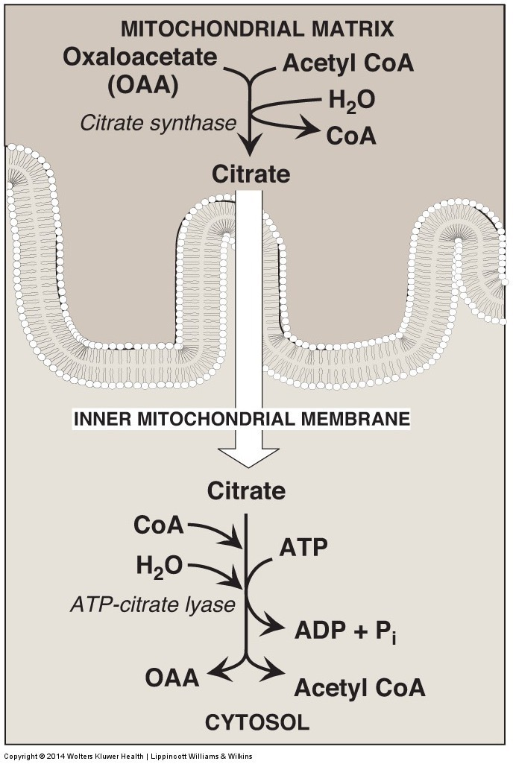
ATP – Citrate Lyase
The problem:
Acetyl CoA is needed for Fatty Acid Biosynthesis in the cytoplasm
Acetyl CoA from PDH/AA Catabolism is in the mitochondria
No AcetylCoA transporters
The solution
Citrate is made in mitochondria
Citrate is transported out, reconverted back to Acetyl CoA by ATP Citrate Lyase
Enzyme activated post-translationally by insulin and transcriptionally by SREBP and ChREBP

Slide 20
About the activity of ACLY
Insulin activates ATP-Citrate Lyase by phosphorylation. How would you characterize these effects?
Anaplerotic, reducing TCA cycle efficiency
Cataplerotic, reducing TCA cycle efficiency
Anaplerotic, increasing TCA cycle efficiency
Cataplerotic, increasing TCA cycle efficiency
Notes:
Answer is B

Slide 21
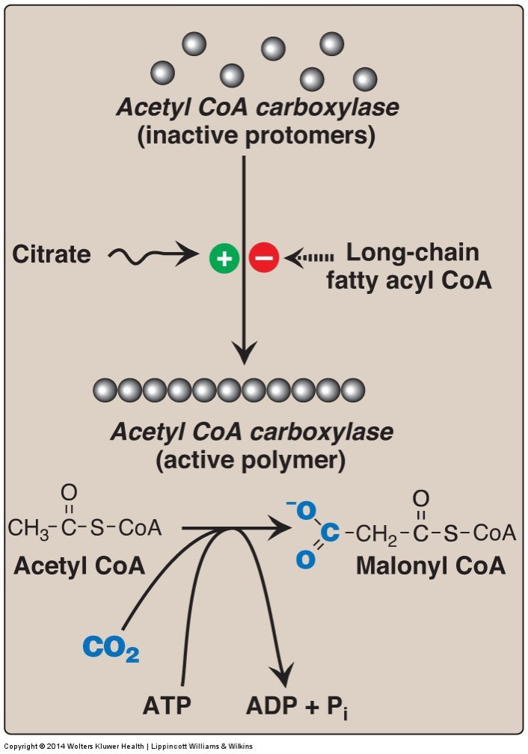
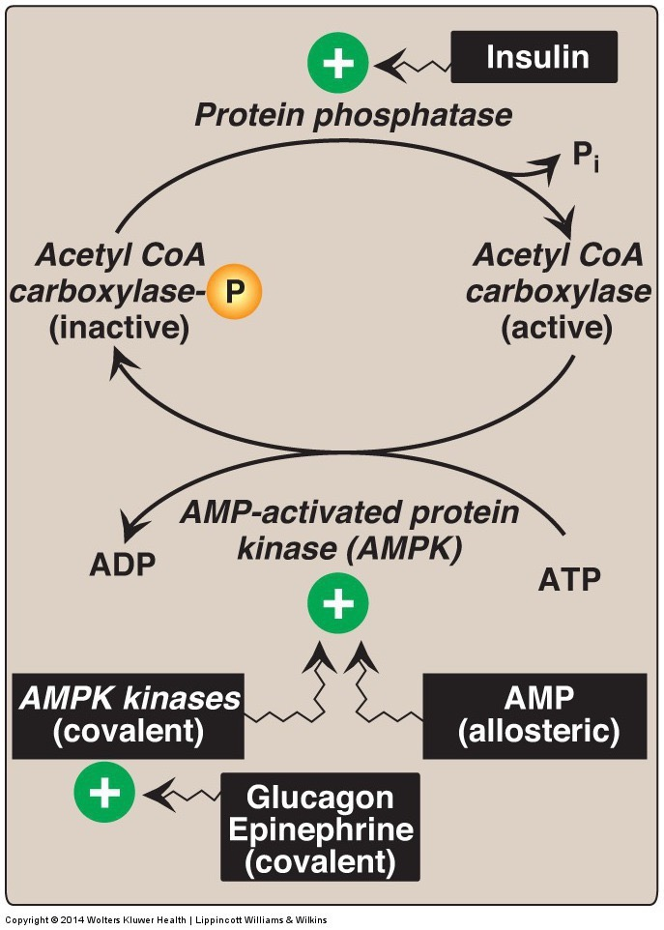
Acetyl CoA Carboxylase
Rate limiting enzyme for fatty acid biosynthesis
Regulated Allosterically
Inactivated by AMPK/PKA
Notes:
So low energy can prevent fatty acid synthesis

Slide 22
Citrate and Carbohydrate Metabolism
Sketch out how de novo lipogenesis and glycolysis are co-ordinated, importantly how and where does citrate affect glucose catabolism if ATP-Citrate Lyase is active.
Will this cause more or less Acetyl-CoA to be made from glucose?
Would this accelerate or decelerate de novo lipogenesis?
Are the same statements true for fructose?

Slide 23
Citrate and Carbohydrate Metabolism

Slide 24
Malonyl CoA Controls the Balance Between FA Synthesis and Degradation
Serves as a substrate for FA synthesis
Prevents re-import of fatty acids into mitochondria
CPT1 is a fatty acid transporter in mitochondria
Therefore Malonyl CoA prevents beta oxidation

Slide 25
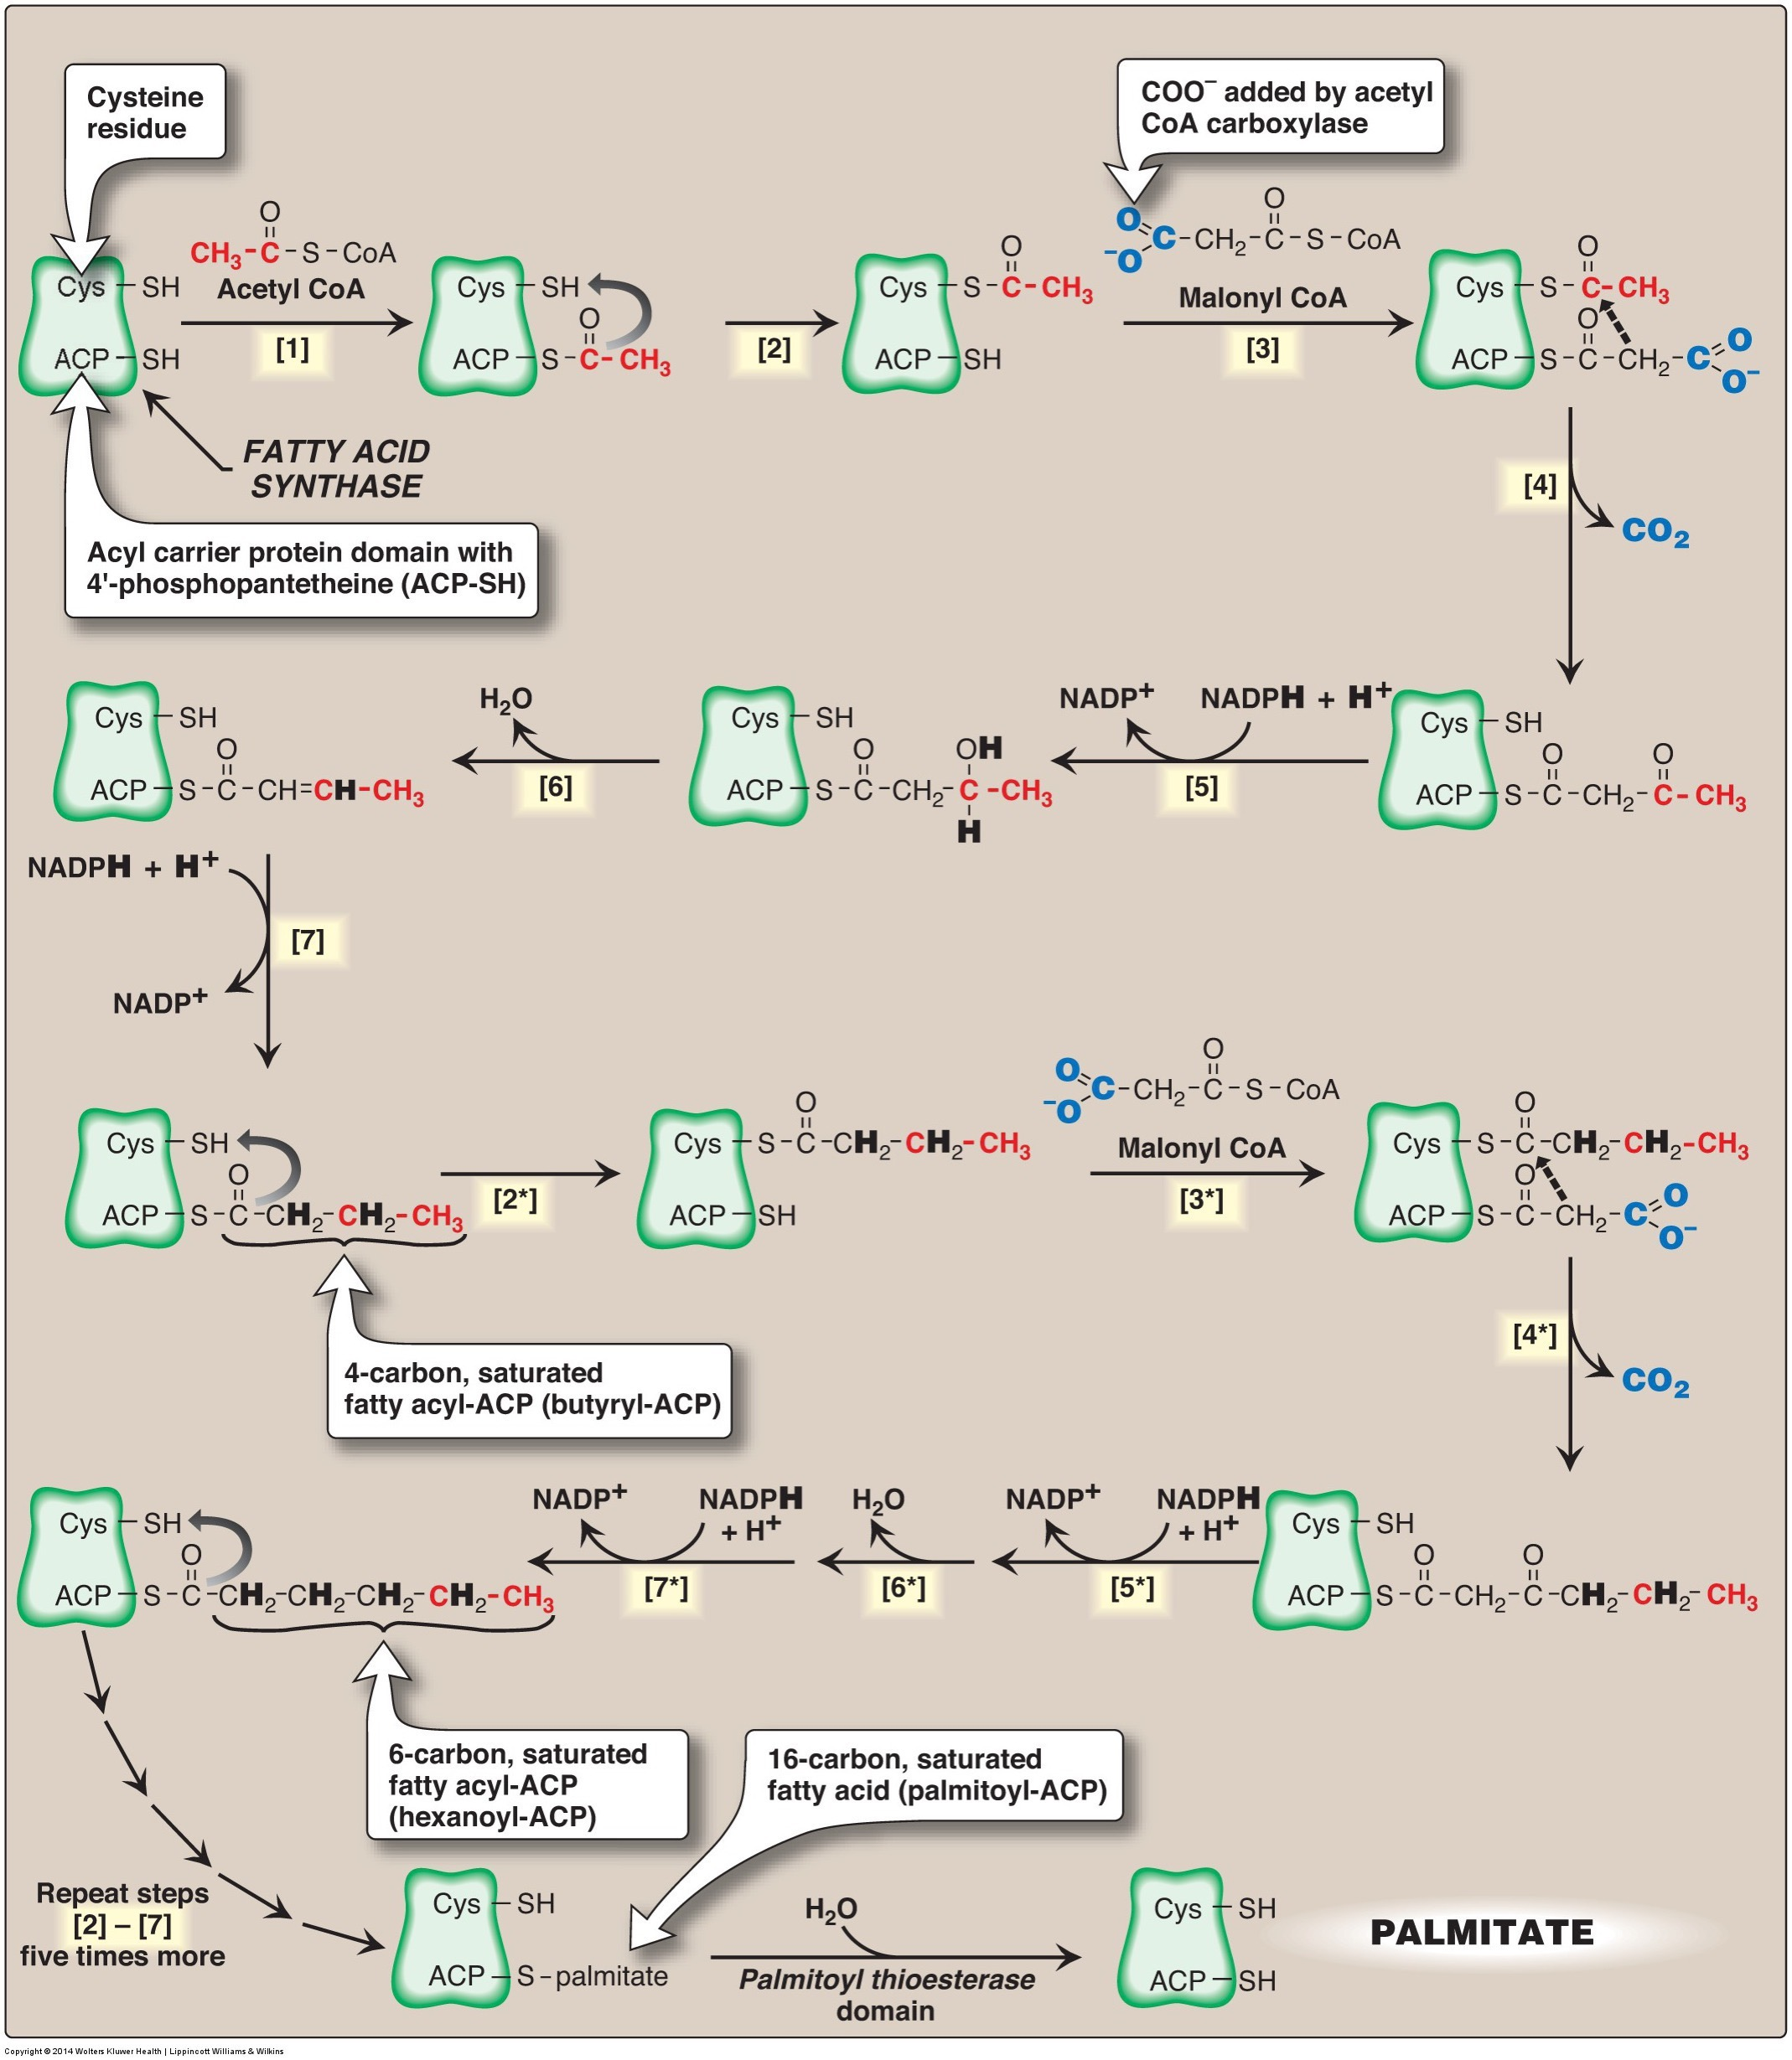
The Rest of Fatty Acid Synthesis is Mediated by Fatty Acid Synthase
Reaction including ACC:
Consumes:
8 Acetyl CoA (Primer then 7 Malonyl-Co from ACC)
7 ATP (to make Malonyl CoA from ACC)
14 NADPH
Makes 1 Palmitate (C16:0)
Additions are made 2 at a time
Very energy costly
Notes:
Plus some other waste products like CO2, ADP, NADP

Slide 26
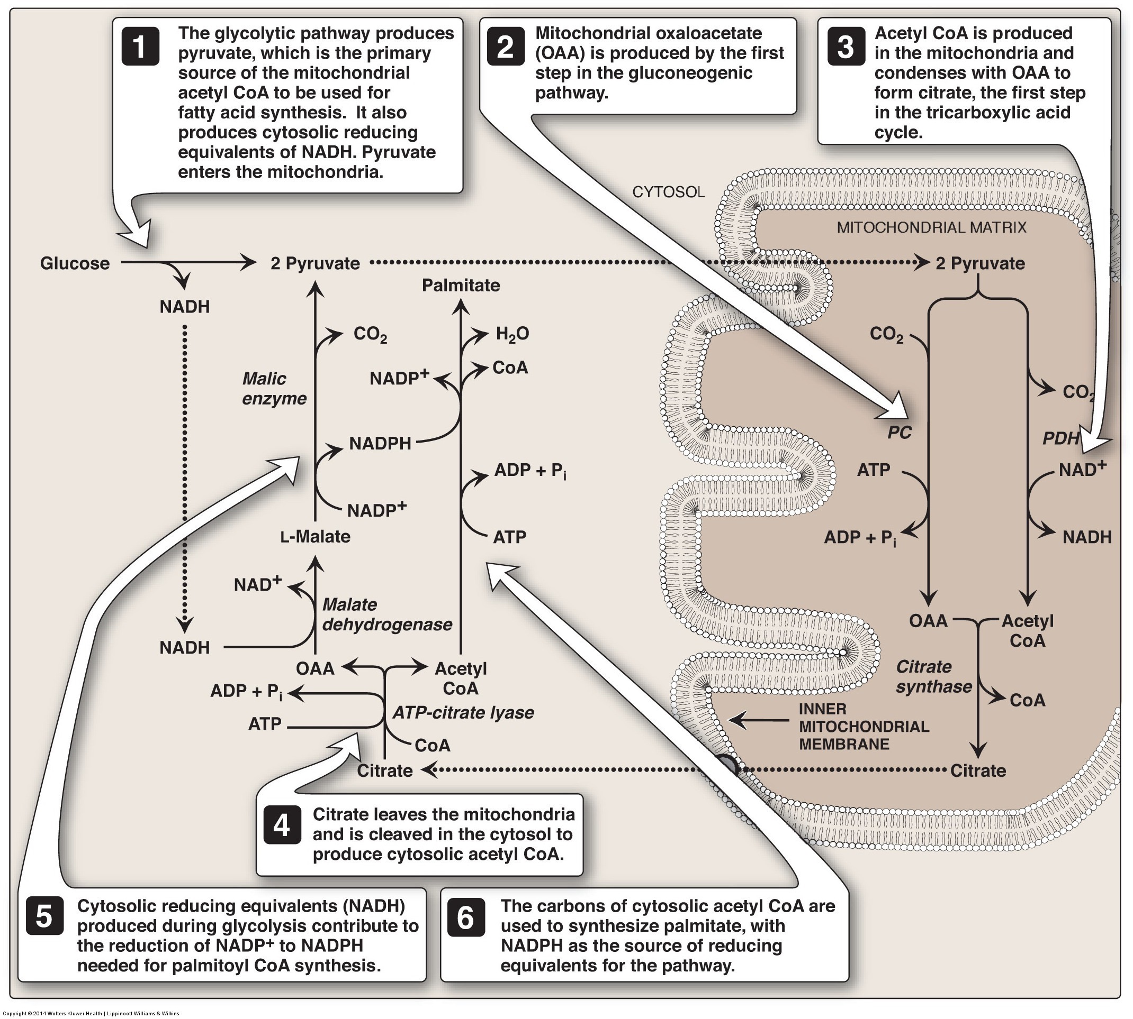
Two Sources of NADPH
First is Pentose Phosphate Pathway
Other ATP-Citrate Lyase Product is OAA
Converted to pyruvate generating one NADPH for each Acetyl-CoA

Slide 27
Transcriptional Control of FA Biosynthesis
ACC, ACLY and FAS are transactivated by
SREBP1c
Regulated by insulin/mTORC1
ChREBP
Regulated by high carbohydrates
GK – Glucokinase
PK – Pyruvate Kinase
EVOVL6 – Elongase
SCD1 – Desaturase (Δ9)
GPAT/DGAT – TG Synthesis

Slide 28
Regulation of SREBP1c
Saturated Fats
Insulin/mTORC1
PUFA

Slide 29
What happens to palmitate (C16:0)?
Further elongation (e.g. ELOVL6) and Desaturation (e.g. SCD1)
Humans have Δ9, Δ6, Δ5, Δ4 desaturases
VLC PUFAs are generated by sequential desaturation/elongation
But no n-3 or n-3 desaturase activity
Notes:
Competition between FA species
Elongations are by a factor of 2

Slide 30
Fatty Acid Exercise
Palmitate (C16)
Based on its length, what activity is closest to the methyl group (Δ9,6,5,4)
What ω-type of fatty acid is formed?
Repeat for stearate (C18)
What length fatty acid would we need to have to make a n-6 or n-3 MUFA, why is this unlikely endogenously?
Notes:
n-7, n-9

Slide 31
Triglyceride Synthesis

Slide 32
Triglyceride Esterification
Fatty Acyl-CoA
P
Fatty Acids
Dietary
From de novo lipogenesis
P
P
Lipin

Slide 33
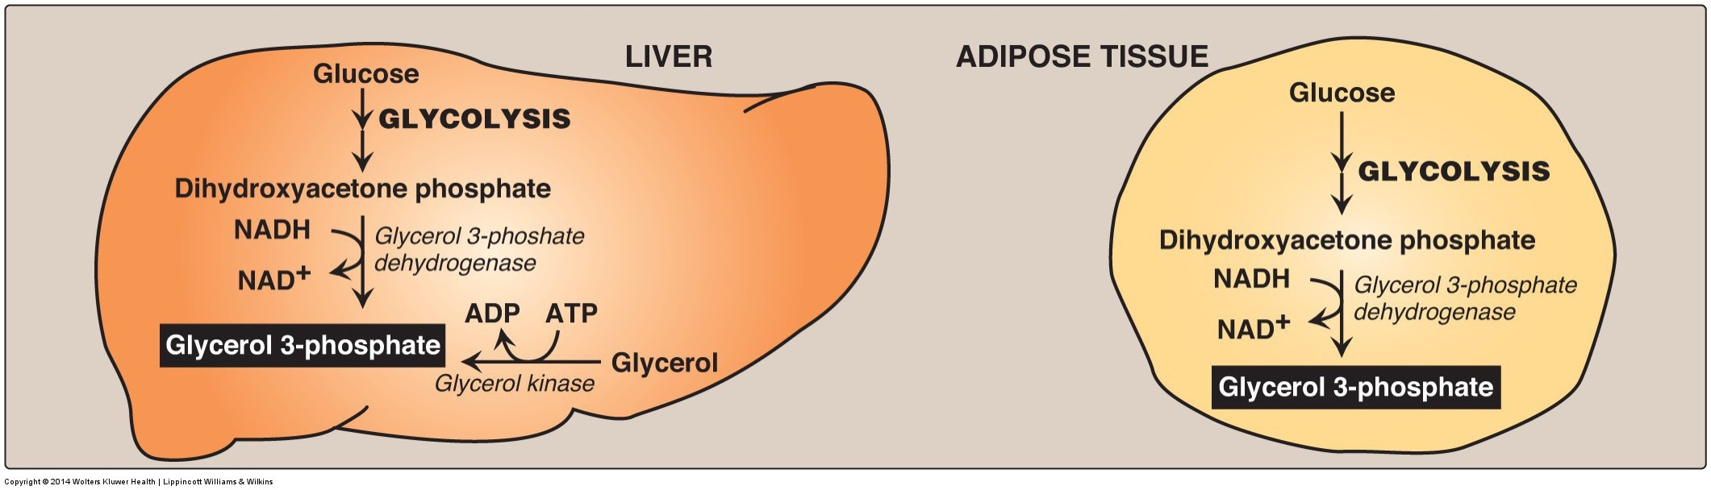
Glycerol for Triglyceride Synthesis
From glycolysis in liver and adipose
From glycerol only in liver
Major demand of glucose during lipid storage

Slide 34
Lipodystrophy and Insulin Resistance
If fat cannot be stored in adipocytes effectively it ends up in liver/muscle/blood vessels
Insulin resistance/diabetes if in the liver
Familial lipodystrophy genes include LMNA, Lipin, AGPAT2

Slide 35
Cholesterol Synthesis

Slide 36
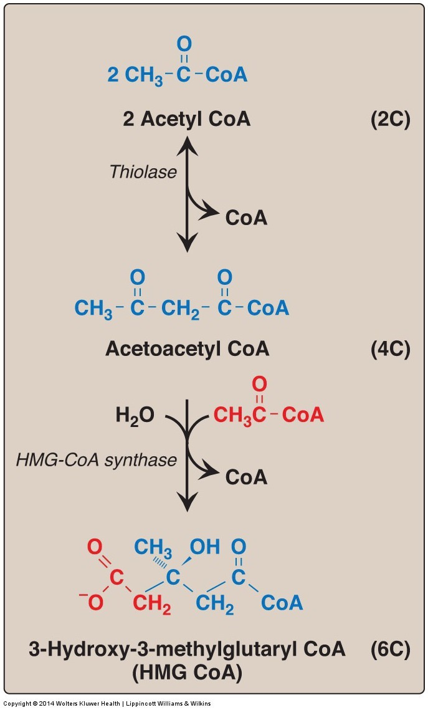
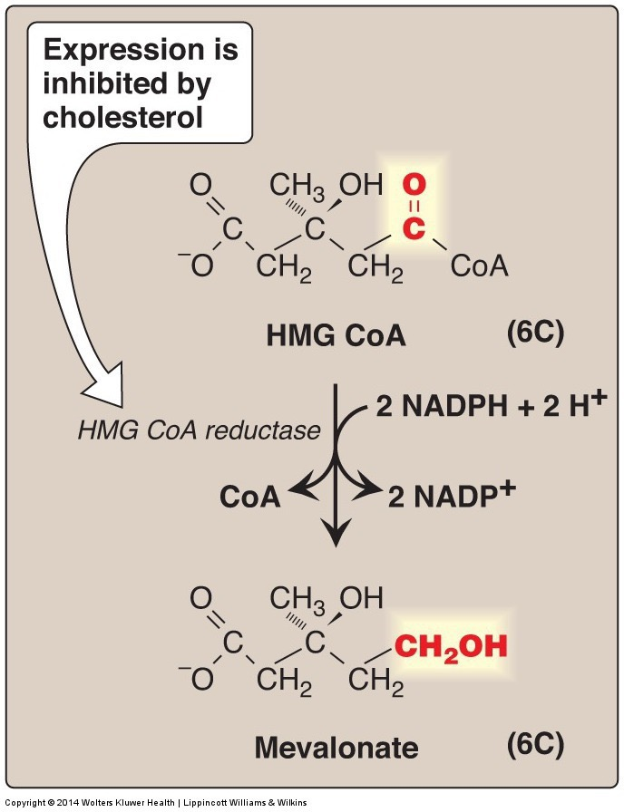
HMG-CoA Reductase

Slide 37
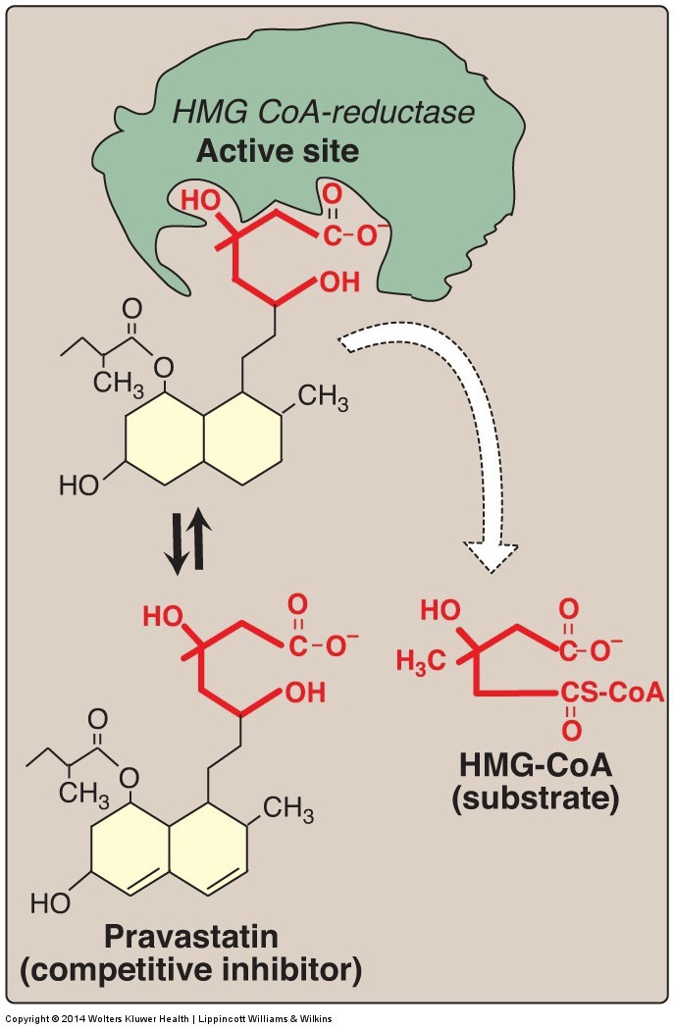
HMGCR is the Target of Statins

Slide 38
Cholesterol Biosynthesis Regulation
Negative feedback on HMG CoA reductase
Dietary intake of cholesterol suppresses production only in liver
Specific sterol responsible for feedback unclear but is most likely a 25-oxysterol
Song BL, Javitt NB, DeBose-Boyd RA. Insig-mediated degradation of HMG CoA reductase stimulated by lanosterol, an intermediate in the synthesis of cholesterol. Cell Metab. 2005; 1: 179–89. doi: 10.1016/j.cmet.2005.01.001.

Slide 39
Transcriptional Regulation of Cholesterol Biogenesis
SREBP2 activation is inhibited by sterols
Targets of SREBP2 reduced when sterols are high:
HMG-CoA Reductase
HMG-CoA Synthase
LDL Receptor

Slide 40
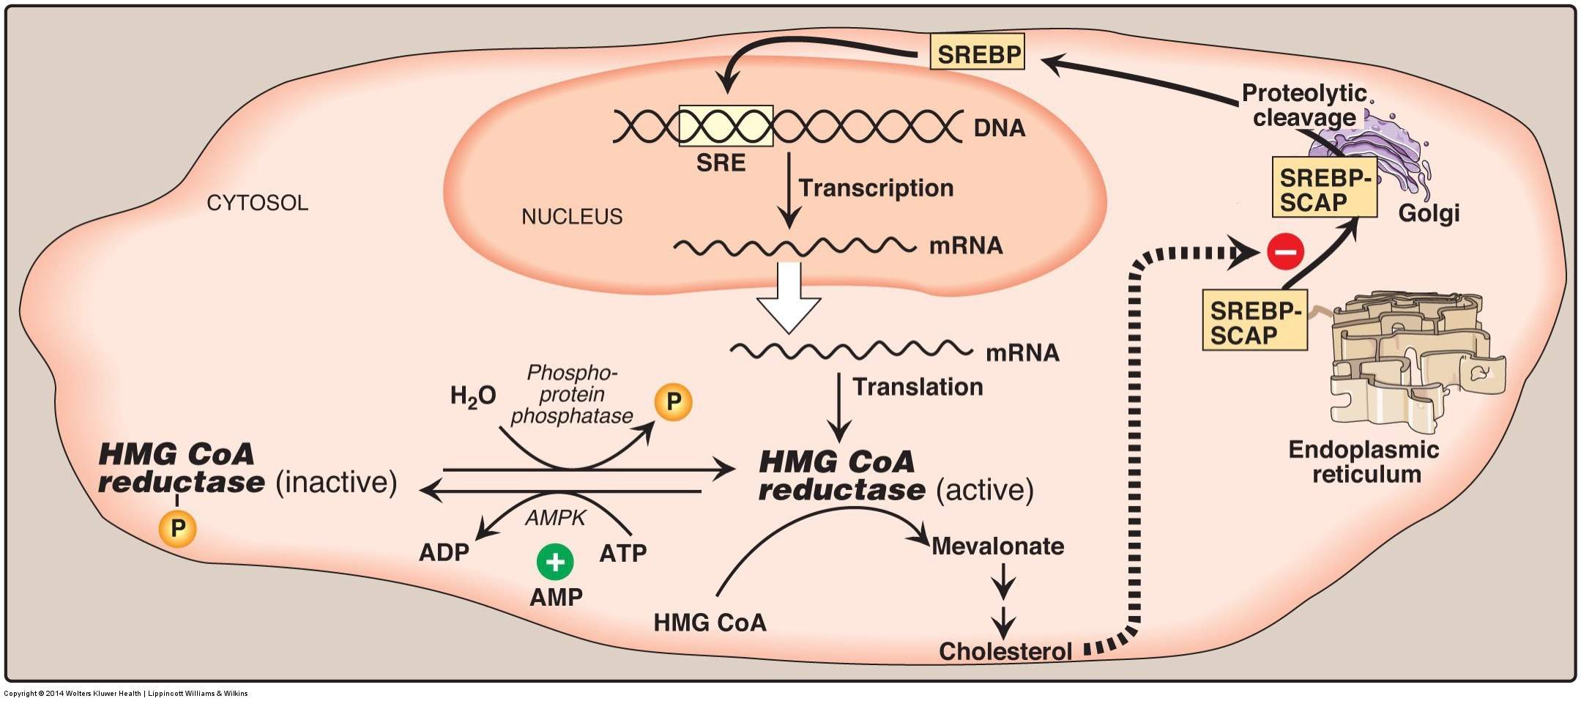
AMPK Regulates Cholesterol Synthesis
AMPK Prevents both cholesterol (HMGCR) and fatty acid synthesis (ACC) when there is energy demand

Slide 41
Ketogenesis
What happens when Acetyl-CoA production exceeds demand?

Slide 42
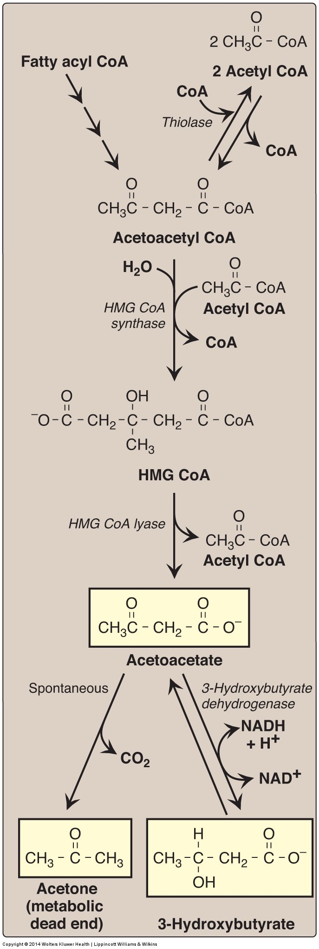
Ketogenesis
Ketogenesis produces ketone bodies
Acetone
Acetoacetate
Beta-hydroxybutyrate
First steps same as cholesterol
Transported to other tissues to be oxidized (converted back to Acetyl-CoA)

Slide 43
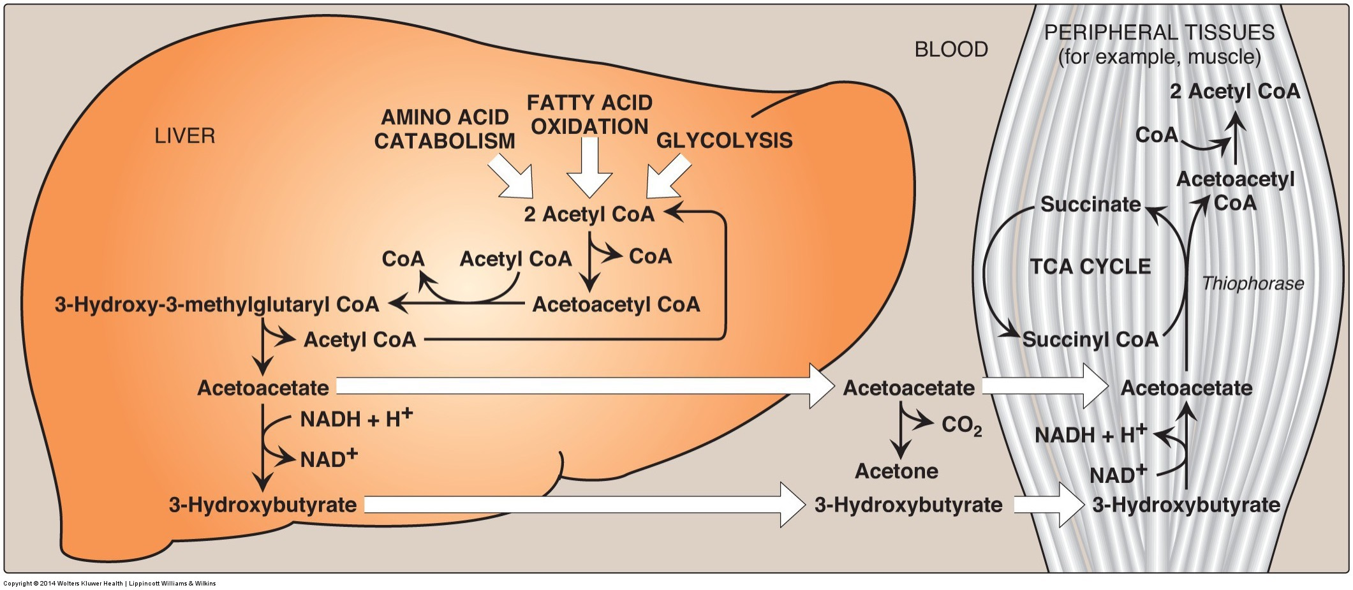
Ketone Bodies
Ketogenesis:
Mainly occurs in liver
Ketones do not stay in liver because it lacks enzyme for initial reaction of ketone body oxidation
Ketone body oxidation: ketone bodies → Acetyl CoA
Brain, heart, muscle, etc.
Acetyl CoA enters TCA cycle

Slide 44
Diabetic Ketoacidosis
Causes
Consequences
Conditions in which build up could occur
Untreated type 1 and type 2 diabetes: Low levels of circulating insulin
Type 1 – beta cells cannot make insulin
Type 2 – beta cells are damaged from prolonged periods of overproduction of insulin
Cannot stop lipolysis, excess Acetyl-CoA in the liver
Accompanied by hyperglycemia
Coma,
Dehydration
excessive urination
vomiting
organ failure
About 140 000 hospitalizations per year in the USA (CDC, 2009)

Slide 45
Ketogenic Diets
Very low carbohydrate diets
Accompanied by normoglycemia
DKA: beta hydroxybutyrate >15 mM
Nutritional Ketosis: beta hydroxybutyrate <3 mM
Notes:
Think in the muscle, what is controlling the levels of OAA

Slide 46
Learning Objectives
Describe the conditions and tissues wherein fatty acids are generated, and from what precursors.
Explain the regulation of fatty acid biosynthesis by metabolite levels and hormones, including how it is ensured that beta-oxidation and de novolipogenesis do not occur simultaneously.
Understand the energy costs of generating fatty acids from glucose, compared with using glucose for fuel. Included in this is the source of carbon units, and reducing equivalents that are necessary for fatty acid biogenesis.
Analyze the role of citrate in co-ordination of glycolysis, TCA cycle activity and lipogenesis.
Explain the causes of lipodystrophy, including the metabolic consequences of ectopic fat deposition.
Understand how transcriptional and post-translational regulation control triglyceride synthesis and cholesterol synthesis.
Analyze the cellular conditions that lead to cholesterol synthesis and ketogenesis.
Describe the roles and activation of SREBP1 and SREBP2 in fatty acid/triglyceride and cholesterol biogenesis respectively.

